Slide 1
Unveiling the Interplay Between Global Link Arrangements and Network Management Algorithms on Dragonfly Networks
Alex Peck & Chile Asante

Slide 2

For starters (as we know)...
Dragonfly is a promising solution for:
Reducing network messaging delay
Handling high bandwidth
Combining these two facts to improve HPC ability

Slide 3
To begin our discussion (did you even read):
What are the main impacts on an HPC system’s performance?
Hardcore computer specz
Network communication efficiency
Scalability
Network communication delay
A select combination of a few of these

Slide 4
To begin our discussion (did you even read):
What are the main impacts on an HPC system’s performance?
Hardcore computer specz
Network communication efficiency
Scalability
Network communication delay
A select combination of a few of these ←

Slide 5

Minor overview
Modern tech advantages all pay dues to efficiency and scalability of an HPC system.
This is where Dragonfly comes in
Key idea: Reducing network hops = shorter delay + low energy consumption

Slide 6

How do we do this?
Dragonfly - Exploits not only minimal network hops, high bandwidth cables, scalability.
Local links form groups
Global links connect individual groups to one another
Previously we discussed different types of arrangements of these connections
Absolute
Relative
Circulant-based
And the routing techniques
Minimal
Valiant

Slide 7
What is the main focus of this paper?
The two-level hierarchy of Dragonfly topology
Background on Dragonfly networks
Performance based on link arrangements and routing mechanisms
Absolute and circulant-based arrangement
A routing analysis for HPC and workload assumptions

Slide 8
What is the main focus of this paper?
The two-level hierarchy of Dragonfly topology
Background on Dragonfly networks
Performance based on link arrangements and routing mechanisms etc.
Job placement algorithms and application communication patterns
Absolute and circulant-based arrangement
A routing analysis for HPC and workload assumptions

Slide 9
Get to the point.. (Experimental methodology)
SST - Structural Simulation Toolkit
Allows experimentation on design, evaluation, and optimization of HPC networks.
Global link arrangements
Allocation/Mapping algorithms
Communication patterns
This specific usage
Packet-level simulations allow to apply all of the above within the Dragonfly topology

Slide 10
What is a scheduler element in an SST?
An advanced application developed by Google to precisely schedule class periods for elementary schools
Estimates wall-clock time of applications through average time hop distance through empirical data
Gives ability to manipulate timing of sending and receiving messages while testing a network setup
A queue that determines the path a message will go based on current traffic.
A built in programming object in the Frostbite Engine for Battlefield 4 that determines spawn rate for vehicles

Slide 11
What is a scheduler element in an SST?
An advanced application developed by Google to precisely schedule class periods for elementary schools
Estimates wall-clock time of applications through average time hop distance through empirical data
Gives ability to manipulate timing of sending and receiving messages while testing a network setup ← Ember and Merlin Elements
A queue that determines the path a message will go based on current traffic.
A built in programming object in the Frostbite Engine for Battlefield 4 that determines spawn rate for vehicles

Slide 12
Scheduler vs Scheduler element
Scheduler
Schedules the jobs, decides when to run them allocates nodes for the jobs, maps tasks to each job onto the allocated nodes depending on the selected scheduling.
Scheduler Element
Advanced allocation (2D/3D mesh, torus), allows implementation of dragonfly topology.
Then…...

Slide 13
Ember and Merlin Elements
Ember and Merlin elements simulate network timing for sending and receiving packets from one end of the network to the other. Communication between these and the scheduler is done through SST.
Ember elements
Models MPI routines in current HPC apps, which are then named in SST as ember motifs
The motifs are then used to implement the message traffic between tasks of the application.
Merlin elements
Works in coop with ember and models behavior of routers, NICs, and routing algorithms.
Capable of capturing behavior resulting from congestion, stalls, and routing in a “cycle accurate manner.”

Slide 14
Job allocation
3 Main types with fundamentally different characteristics
Cluster
Fills available nodes in order until entire group is filled, then moves on to the next
Spread
Spreads job uniformly among groups in a “round robin” manner. Starting in group 0, then once filled it goes to group 1, and so forth.
Random
Literally randomly distributes jobs from a set of available notes

Slide 15
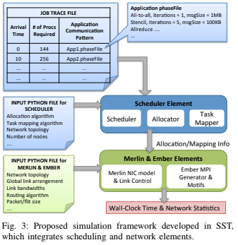
This is then used to implement Dragonfly

Slide 16
With all this implemented within the system, the communication patterns are then studied

Slide 17
What is the “All-to-all” pattern?
Tasks exchange messages with six nearest Cartesian neighbors
Each task communicates with every one of the other tasks
A cute pattern used when drawing with Crayola crayons
Tasks are divided into three equal sized groups
wut

Slide 18

What is the “All-to-all” pattern?
Tasks exchange messages with six nearest Cartesian neighbors
Each task communicates with every one of the other tasks
A cute pattern used when drawing with Crayola crayons
Tasks are divided into three equal sized groups
wut

Slide 19
What is the “bisection” pattern?
Tasks exchange messages with six nearest Cartesian neighbors
Each task communicates with every one of the other tasks
We already talked about this
Tasks are divided into two equal sized groups
Allocating bandwidth between two network receivers to interchange tasks and messages

Slide 20
What is the “bisection” pattern?
Tasks exchange messages with six nearest Cartesian neighbors
Each task communicates with every one of the other tasks
We already talked about this
Tasks are divided into two equal sized groups
Allocating bandwidth between two network receivers to interchange tasks and messages

Slide 21
What is the “3D Stencil” pattern?
I swear if you mention Crayola again..
Each task communicates with every one of the other tasks
Tasks exchange messages with six nearest Cartesian neighbors
Tasks are divided into two equal sized groups
Allocating bandwidth between two network receivers to interchange tasks and messages

Slide 22

What is the “3D Stencil” pattern?
I swear if you mention Crayola again..
Each task communicates with every one of the other tasks
Tasks exchange messages with six nearest Cartesian neighbors
Tasks are divided into two equal sized groups
Allocating bandwidth between two network receivers to interchange tasks and messages

Slide 23
Starting Analysis
Each communication pattern has specified parameters
Message size
Number of iterations
Computed time per iteration
Then they are applied in single and multiple job cases within all 3 communication techniques.

Slide 24
Single Job Analysis
Bisection Bandwidth
Circulant performed best, due to balanced cutting (talked about this last time)
Roughly 15% shorter running time, better performance with increasing α values
Realistic Workloads
Bisection isn’t normally used in HPC workloads. Virtually no difference in performance between the 3 when using realistic workloads.
The difference here is seen with the routing pattern used.
Valiant routing provides a bottle-neck with larger message sizes since it doesn’t use minimum path.

Slide 25
Why is bisection not usually used in HPC?
It isn’t very efficient with scalability
It’s better for other uses
There is no need to bisect when using HPC
Two or more of above
The paper doesn’t define this reasoning.

Slide 26
Why is bisection not usually used in HPC?
It isn’t very efficient with scalability
It’s better for other uses
There is no need to bisect when using HPC
Two or more of above
The paper doesn’t explicitly define this reasoning.
The closest to a given answer -> “Global link arrangements do not have an impact on running time” / Probably due to the lack of difference in performance.

Slide 27
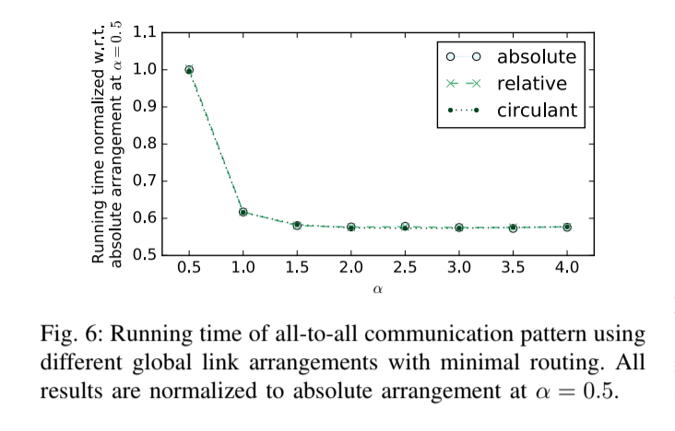

Slide 28
Multiple Job Analysis
Explores the dependency of performance on various network parameters when two jobs are running simultaneously.
Job Allocation
Multi Job analysis focuses primarily on the three job allocation strategies. (Cluster, Spread and Random)
Stencil communication
Small machine and stencil communication patterns run together and the running time of the slower job is reported
Circulant arrangement provides shorter runtimes

Slide 29
What happens to traffic on local links as α increases?
There is no significant impact
Stencil communication is lowered by 15%
All-to-all jobs are much more effective
Traffic is congested due to Valiant routing
Low-level simulators are unified to the simulation framework

Slide 30
What happens to traffic on local links as α increases?
There is no significant impact
Stencil communication is lowered by 15%
All-to-all jobs are much more effective
Traffic is congested due to Valiant routing
Valiant routing creates more traffic on all links. Best performance depends on the value of α.
Low-level simulators are unified to the simulation framework

Slide 31
Key findings / Summary
Circulant arrangement provides up to 15% shorter running time compared to absolute using bisection with minimal routing
For realistic patterns (All-to-all / 3D stencil) Global link arrangements don’t have really any impact on performance
For realistic workloads, routing and allocation paired algorithms has a larger impact than choice of link arrangements. Best performing pair comes with the value of α
Task mapping severely impacts running time

